Slide 1
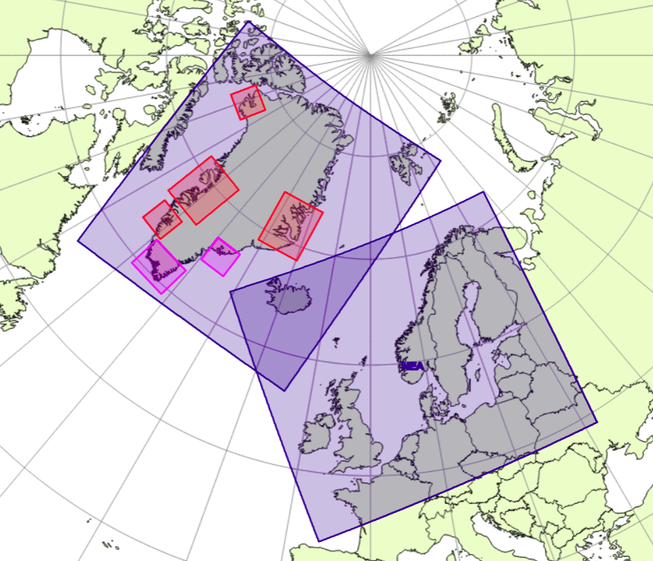
Data assimilation in DMI-HARMONIE
What is HARMONIE?
Data assimilation in NWP : some basics
Why LAM ?
Ensemble sub-km nowcasting
Xiaohua Yang, Chefkonsulent, F & U, DMI, 19 Jan 2021

Slide 2
What is HARMONIE system?
Weather Research Consortia in Europe
--- HARMONIE is the weather forecasting system used for operational weather forecasting at DMI
--- It is jointly developed by members of HIRLAM consortia, and in collaboration with ECMWF and Meteo France-lead ALADIN consortia
--- HIRLAM + ALADIN has now merged into ACCORD consortia ( A Consortium for COnvection-scale modelling Research and Development), with 26 European and Mediterranean NWS
Xiaohua Yang, Data Assimilation in DMI-HARMONIE, 19 Jan 2021

Slide 3
Numerical Weather Prediction: basic principles
Weather phenomena can be represented by a set of meteorological parameters: pressure, temperature, wind, humidity, cloud, hydrometers, ...
Evolution of weather is governed by physical law, which can be represented by a set of partial differential equations along temporal and spatial space
Given initial (in time) and boundary (in space) conditions, the equation set for atmospheric states can be discretized on a grid mesh and solved numerically by super computer, resulting in forecast about future atmospheric states
Initial conditions, which describes the current weather situations, is derived by combination of observation and model (data assimilation)
Xiaohua Yang, Data Assimilation in DMI-HARMONIE, 19 Jan 2021

Slide 4
(Roger R)

Slide 5
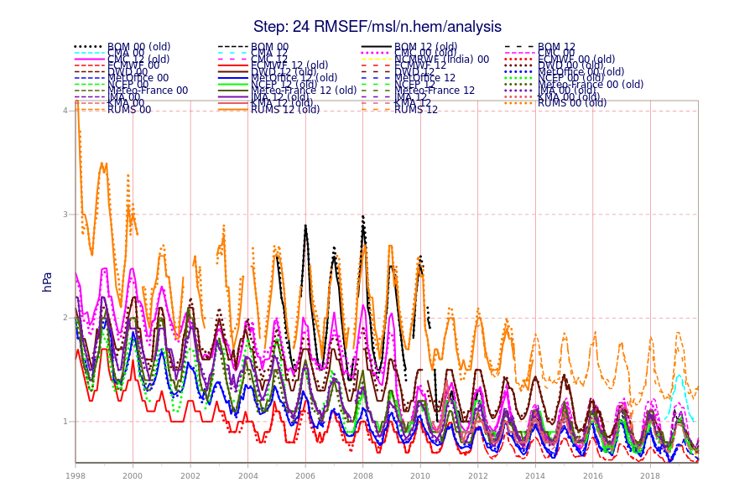
ECMWF has been the leader on global NWP...
ECMWF
UKMO
NCEP
DWD, MF
CMC
KMA, BOM, NCMRWE
CMA
RUM
Canada
DWD
China
UKMO
ECMWF
Russian
(Source: ECMWF annual report to TAC, 2019)
NCEP

Slide 6
Why Limited Area Model?
Some variability in weather depends strongly on local conditions, requiring local knowledge
Many applications requires
frequent, high resolution and timely forecast
(public, aviation, internet apps)
Resolution leads to better forecast, especially for short range
 | Resolution | Lead-time | Update frequency
ECMWF | 9 km HRES, 18 km EPS | 15 day, 45 day | 6, 12h to 2/week
DMI | 2.5 km, 1km, 750 m | 66h, 60h, 54h | 1h, 3h

Slide 7
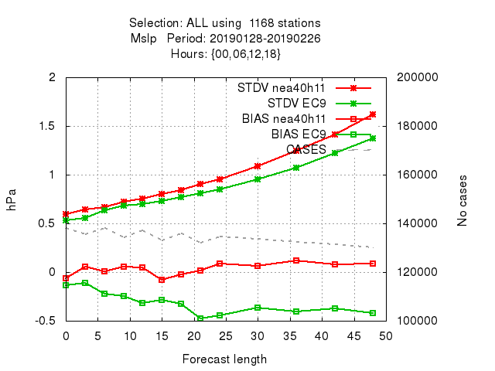
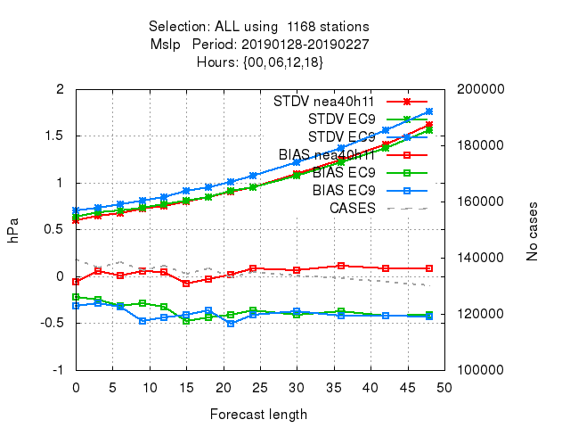
Crucial importance with delivery time
DMI
ECMWF
DMI
ECMWF, 3h delay
ECMWF, 12h delay
Forecast with same basetime
Latest available forecasts
Notes:
Traditional observation verification intercomparison, which compares model data against in-situ measurement among models, usually are made with model data of same basetime, such as 00 UTC LAM vs 00 UTC IFS data.
LAM model usually loses on STD error for MSLP and other upper air scores even for short range. The example above compares scores of DMI-HARMONIE for NEA domain (Northern Europe, 2.5 km grid) against ECMWF HRES (9 km) , for which HARMONIE clearly is inferior. (Left panel)
However, if one make an offset of the ECMWF data taking into account its late delivery, (user scenario), the situation changes, ---- HARMONIE scores become comparable or better. (right panel)

Slide 8
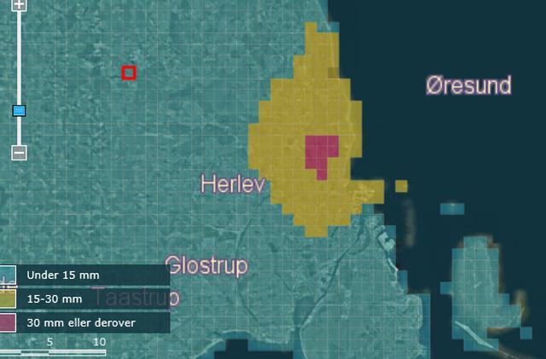
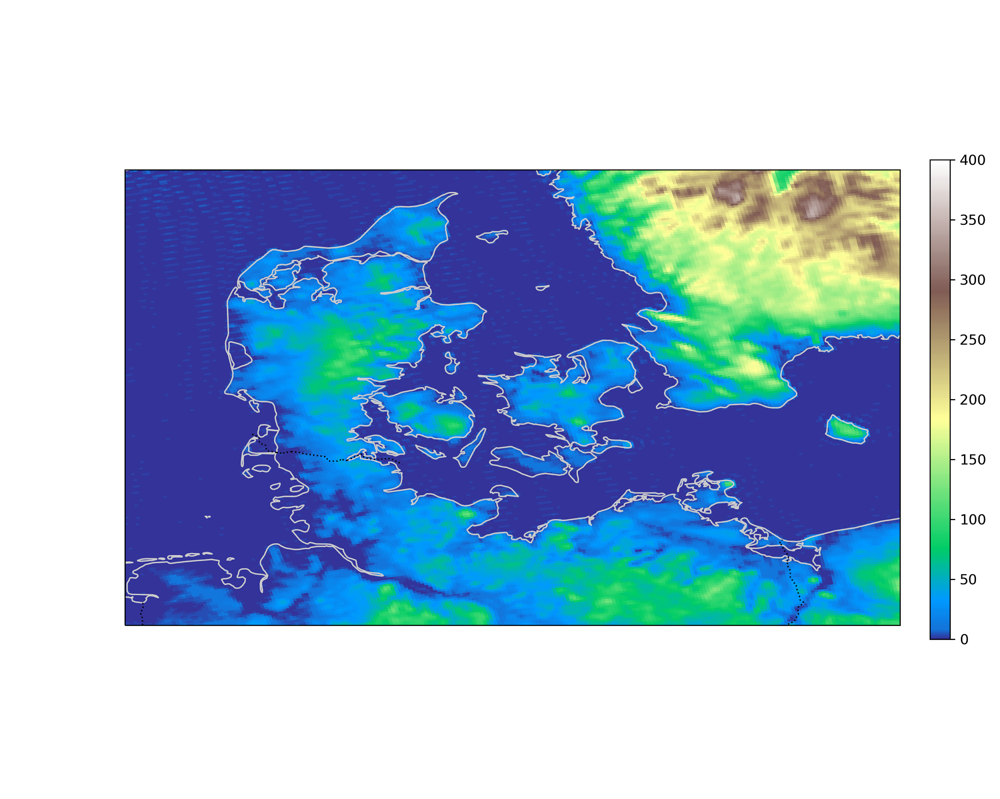
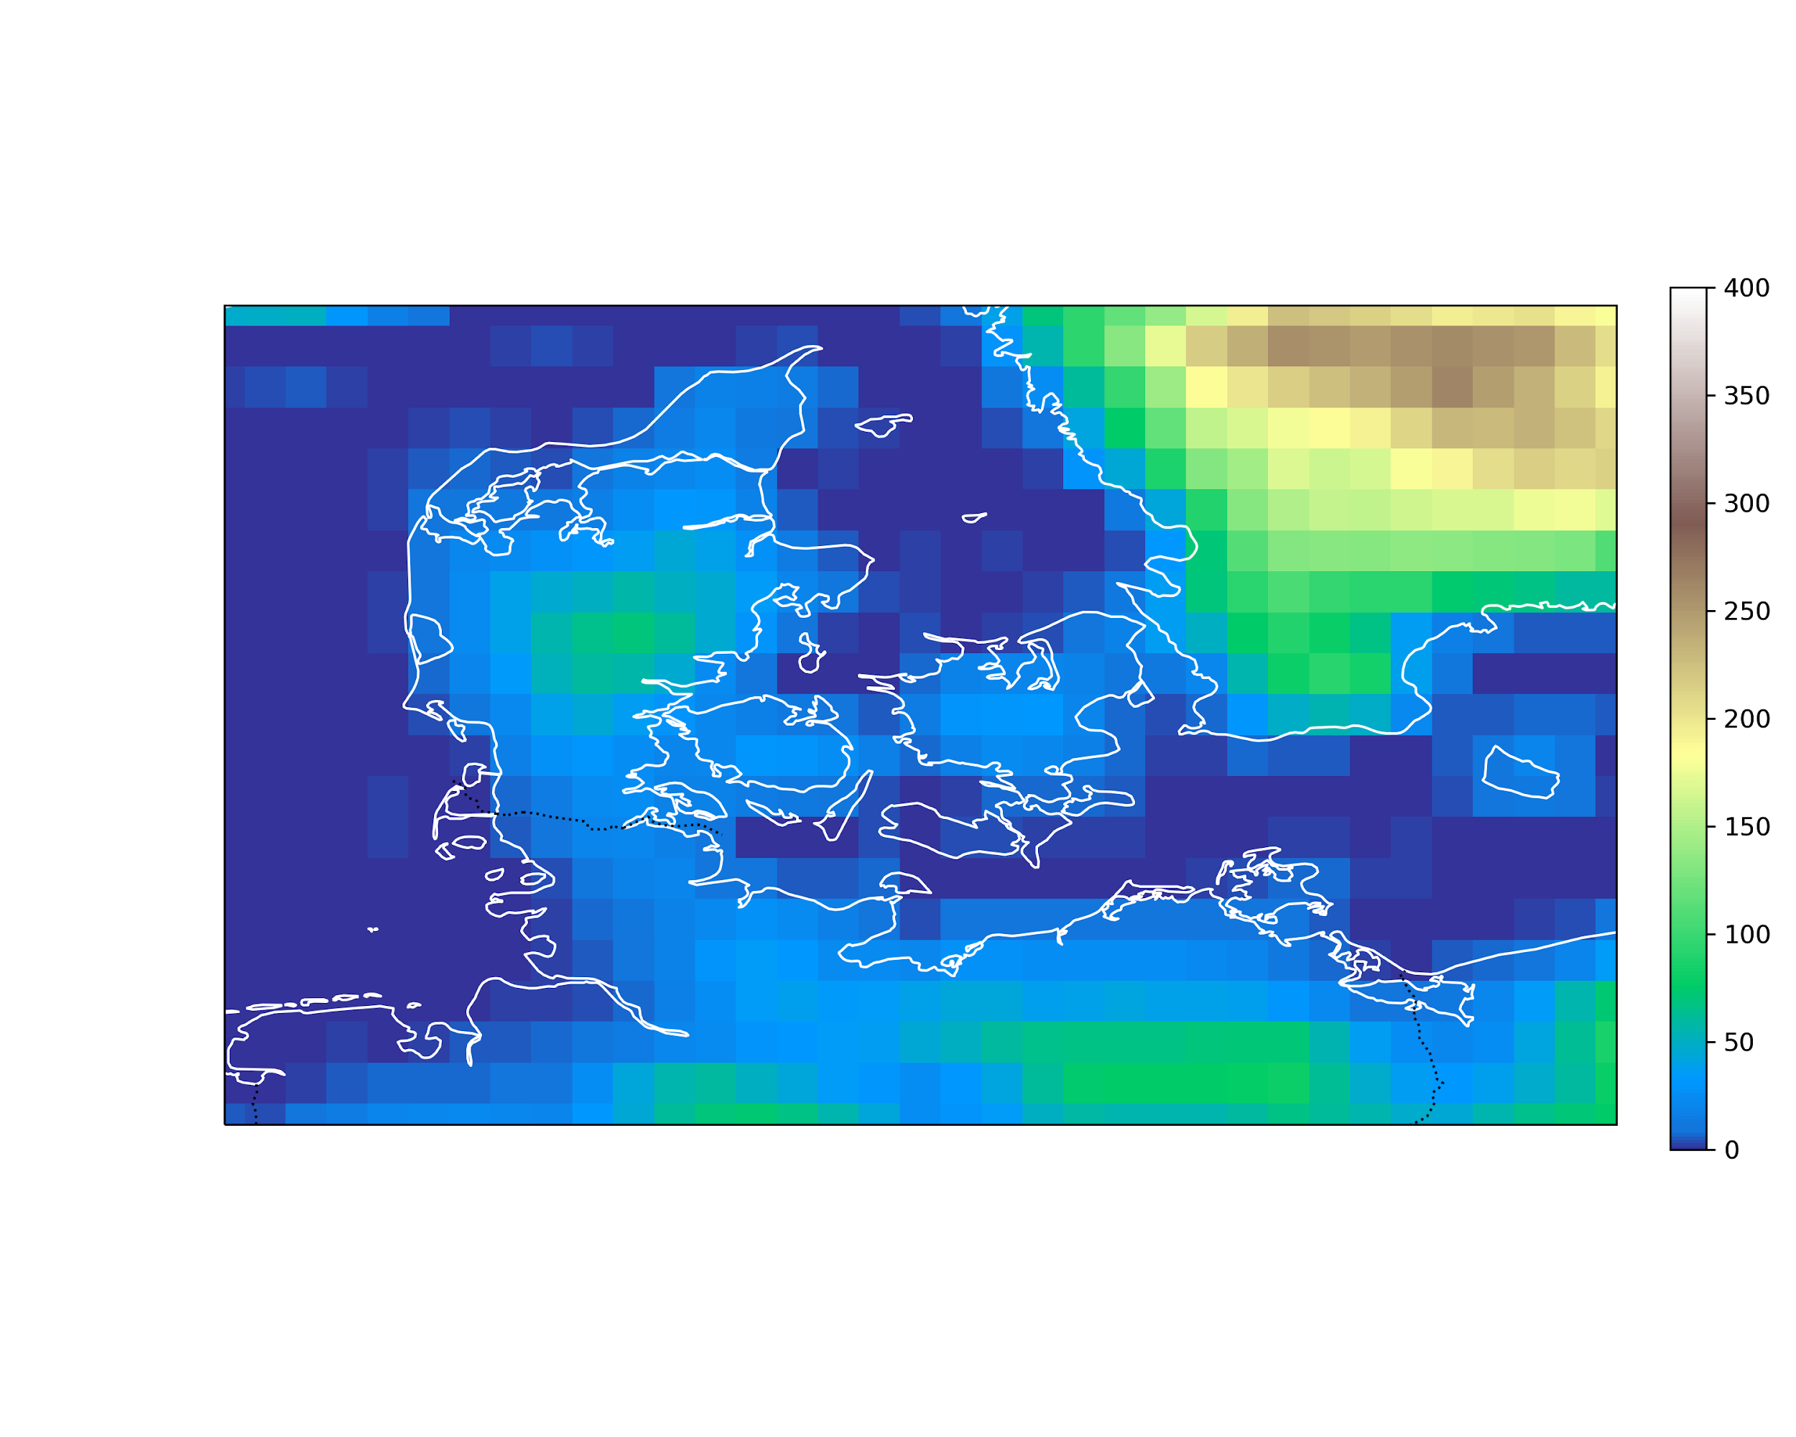
Resolution is essential!
In 2020, NCKF in DMI launched a 2.5 km reanalysis project
DANRA, aiming for a 70 year reanalysis for Denmark.... ....
DANRA, 2.5 km
ERA5, 31 km

Slide 9
Representation of hurricanes in HARMONIE
Danish category 4 storms | Wind Speed Maxima [m/s]
 | OBS | DANRA | ERA5
1981-11-24 | 35.0 | 28.5 | 26.2
1983-01-18 | 31.4 | 27.4 | 23.2
1990-02-26 | 31.0 | 28.6 | 23.6
1991-01-09 | 33.0 | 29.9 | 24.5
1999-12-03 | 41.2 | 39.5 | 27.5
2013-10-28 “Alan” | 38.0 | 33.7 | 23.6
2013-12-05 “Bodil” | 31.4 | 31.2 | 25.8
Peak mean wind as observed and simulated in the Danish (DANRA) and global reanalysis (ERA5) for some of the hurricane events in recent decades.
(Yang, Hintz, Aros & Amstrup , 2021, DMI report 21-31 on DANRA)

Slide 10
Representation of major flashfloods in DANRA
20070820
20100814
20140830
20110702
(Yang, Hintz, Aros & Amstrup , 2021, DMI report 21-31 on DANRA)

Slide 11
Challenges with convective precipitation extreme:
It may easily be missed by observation
network!
Aug 20, 2007, South Jutland
156 mm!
2 mm/6 h!

Slide 12
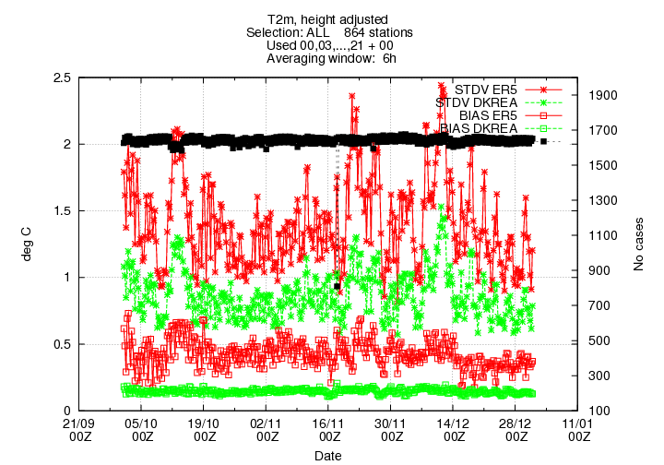
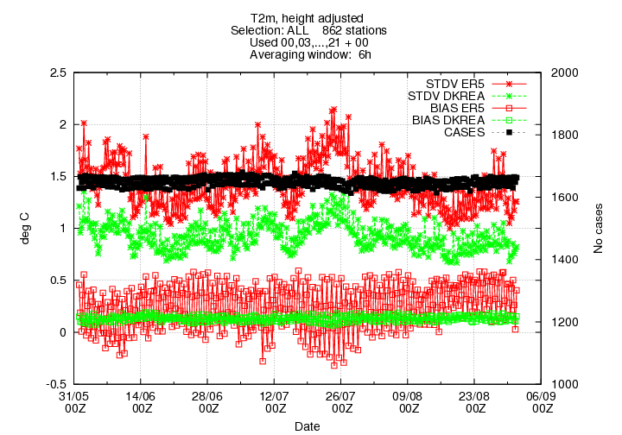
High fidelity with DANRA on T2m
Oct-Dec 2013
Jun-Aug 2014
STD
&
Bias
DANRA (2.5 km HARMONIE)
ERA5 (31 km IFS)
(Yang, Hintz, Aros & Amstrup , 2021, DMI report 21-31 on DANRA)

Slide 13
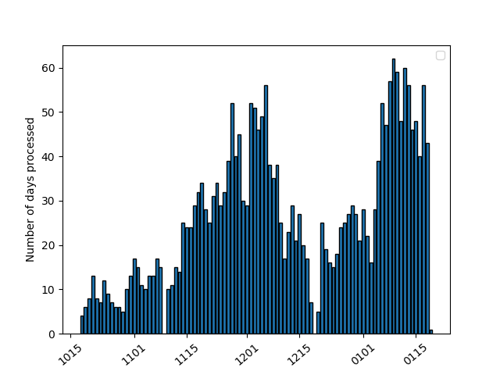
Towards a 70 year reanalysis DANRA
with 2.5 km DMI-HARMONIE, for 1950-2020, + a NRT reanalysis
Also, DMI is involved in production of a 24-year Copernicus Arctic Regional ReAnalysis due this summer.
(Yang, Hintz, Aros & Amstrup , 2021, DMI report 21-31 on DANRA)

Slide 14
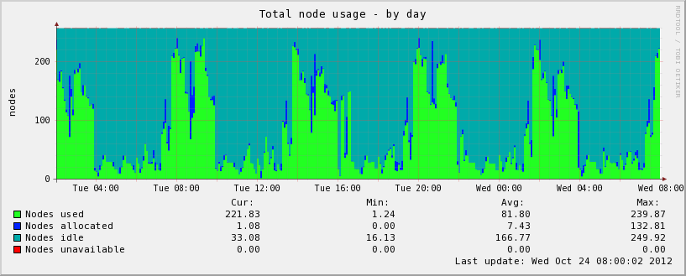
A tale about 6h/12h cycling... ...
2012
6h regular cycling
~25% capacity utilisation
Number of utilised nodes on the operational DMI HPC
... ... How do we get from here to ensemble forecasting?
Xiaohua Yang, Data Assimilation in DMI-HARMONIE, 19 Jan 2021

Slide 15
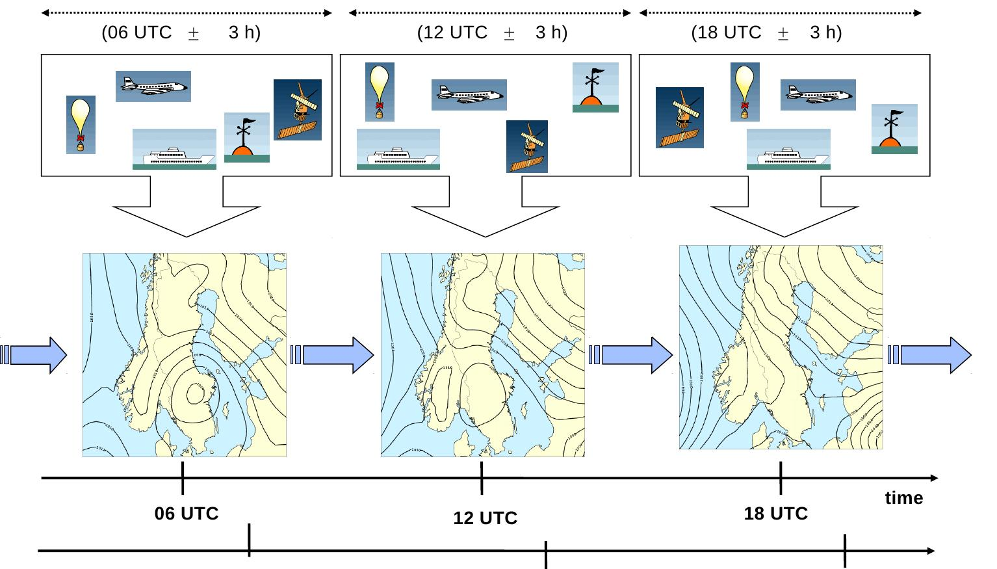
Intermittent data assimilation cycling
OBS
Data assimilation
Data assimilation
Data assimilation
Model
Forecast
Forecast
Forecast
Forecast
In-situ,
Manuel,
“Synoptic”
Xiaohua Yang, Data Assimilation in DMI-HARMONIE, 19 Jan 2021

Slide 16
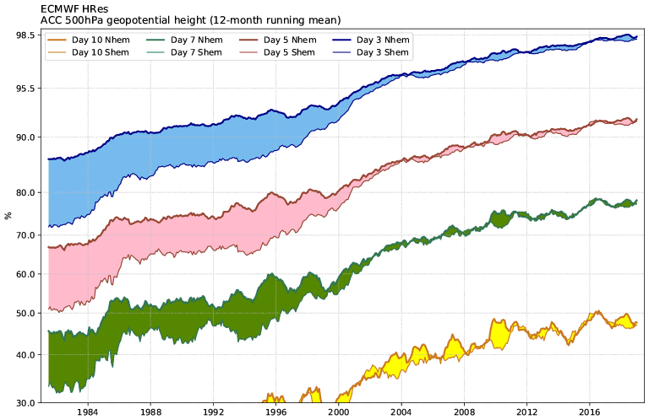
Evolution of forecast quality at ECMWF
(Source: ECMWF)
Satellite data assimilation improves greatly forecast skill. Most clear with southern hemisphere
Xiaohua Yang, Data Assimilation in DMI-HARMONIE, 19 Jan 2021

Slide 17
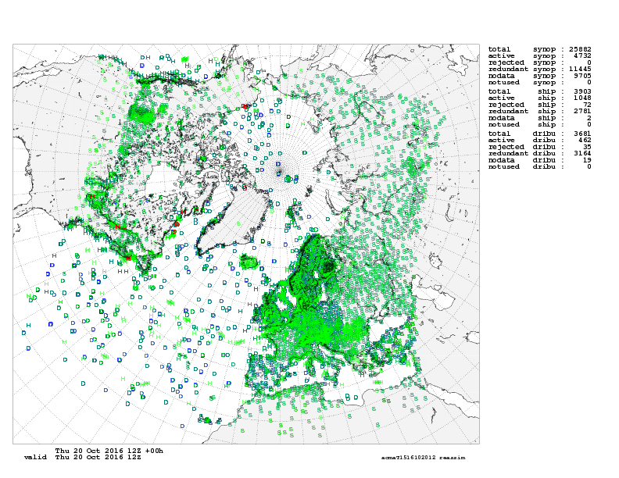
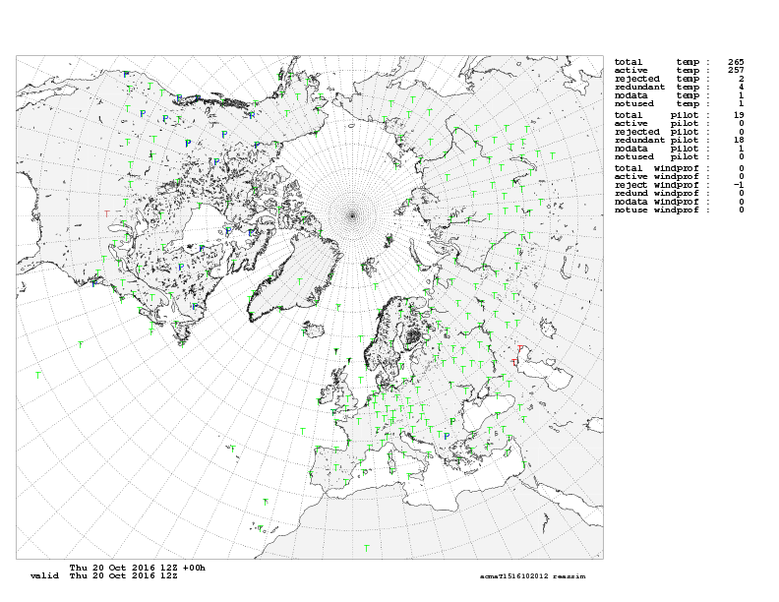
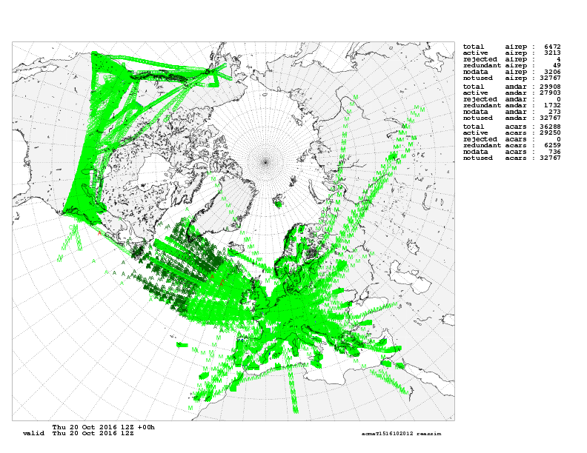
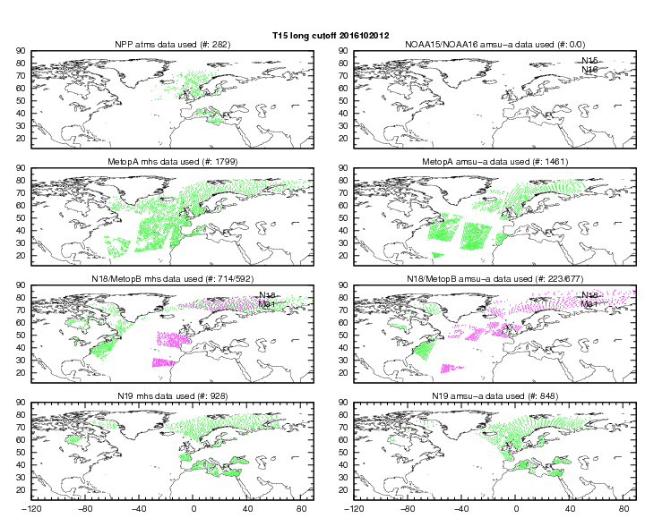
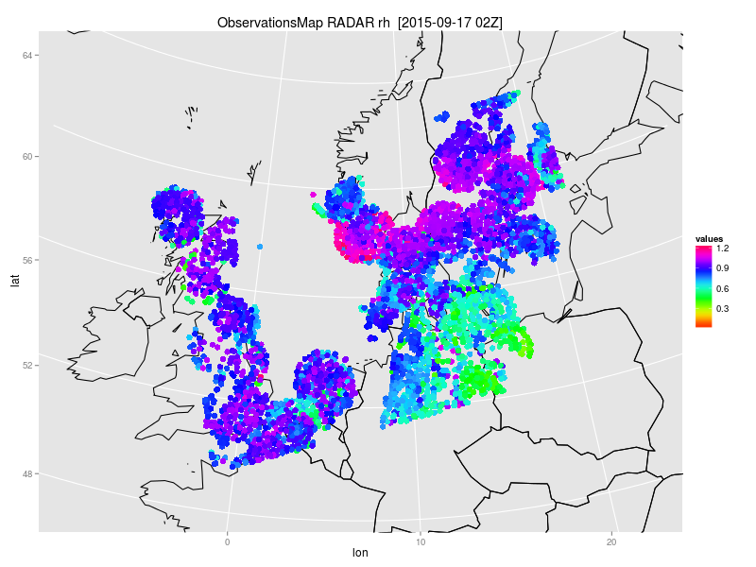
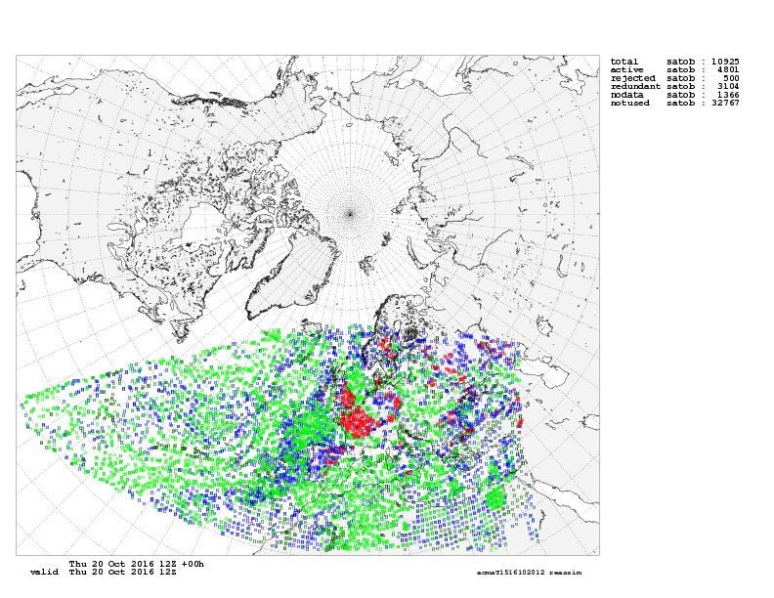
Available observations at DMI
... ... Most are continuous, asynoptic!
SYNOP
SHIP
BUOY
ROAD SENSOR
AMDAR,
E-AMDAR
ACARS
MODE-S
TEMP
PILOT
RADIANCE, RO
RADAR
AMV

Slide 18
Radar, AO & synoptic data critical for HARMONIE
Radiosonde data
no longer
backbone in LAM DA!
(Courtesy of Pierre Brousseau et al, HIRLAM ASM 2012 )

Slide 19
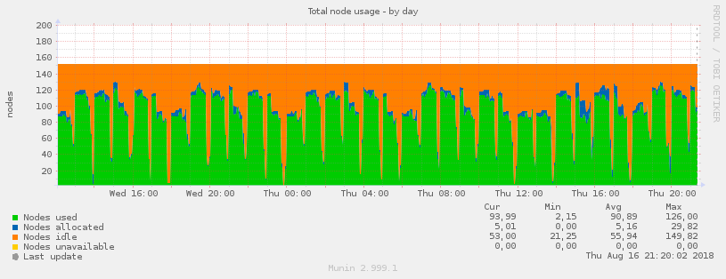
DMI innovations on HPC utilisation
2012
6h regular cycling
~25% capacity usage
Intermittent DA
Asynoptic cycling (2013)
COMEPS (2017)
2018
1h cycling COMEPS
~60% capacity usage
Continuous DA
Xiaohua Yang, Data Assimilation in DMI-HARMONIE, 19 Jan 2021

Slide 20
COntinuous
Mesoscale
Ensemble
Prediction
System
COMEPS: a 25 member time lagged kilometer-scale EPS with hourly refresh (2017, DMI)
Xiaohua Yang, Data Assimilation in DMI-HARMONIE, 19 Jan 2021

Slide 21
How to achieve frequent analysis update
Cycling strategy with intermittent DA
1h cycling,
1h update.
Assimilation window 1h, data between -0.5 and 0.5 h
Background from 1h forecast of previous cycle
Computationally intensive for EPS application
Too short for obs use (TEMP/satellite)?
spin-up (moisture...)
shorter cycling interval unrealistic (balance, temporal correlation, delivery)
fast/frequent assimilation (radar)
Xiaohua Yang, Data Assimilation in DMI-HARMONIE, 19 Jan 2021

Slide 22
How to achieve frequent analysis update
Cycling strategy with intermittent DA
22
00
02
04
2h cycling
1h update
23
01
03
05
Assimilation window 2h, data between -1 and 1 h
Background from 2h forecast of previous cycle
Xiaohua Yang, Data Assimilation in DMI-HARMONIE, 19 Jan 2021

Slide 23
How to achieve frequent analysis update
Cycling strategy with intermittent DA
3h cycling
1h update
00
03
22
01
04
23
02
05
extended use of obs (longer window, less thinning)
reduced spin-up
feasible for larger, time lagged ensemble
better load balance for ensemble model
Assimilation window 3h, ( -1.5 and 1.5 h)
Background from 3h forecast of previous cycle
Xiaohua Yang, Data Assimilation in DMI-HARMONIE, 19 Jan 2021

Slide 24
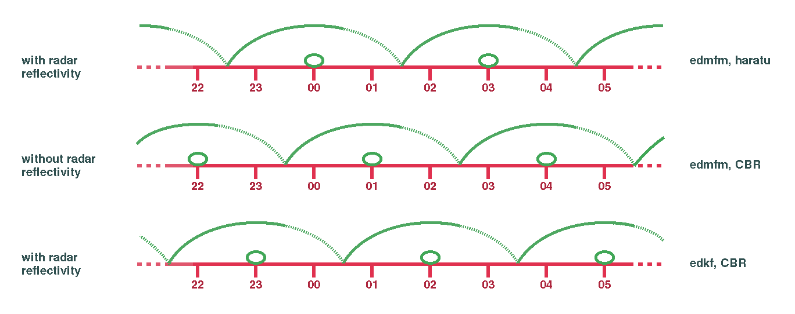
Continuous Meso-scale EPS
3DVAR
3DVAR
4X
3DVAR
3DVAR
3DVAR
4X
3DVAR
3DVAR
3DVAR
4X
Xiaohua Yang, Data Assimilation in DMI-HARMONIE, 19 Jan 2021

Slide 25
Continuous Meso-scale EPS
Cycling Strategy: DA on overlapped windows
3DVAR
3DVAR
4X
3DVAR
3DVAR
3DVAR
4X
3DVAR
3DVAR
3DVAR
4X
Parallel, independent DA suites allow increased use of observations
Xiaohua Yang, Data Assimilation in DMI-HARMONIE, 19 Jan 2021

Slide 26
Continuous Meso-scale EPS
Cycling Strategy: EDA along time
Varying Obs
3DVAR
3DVAR
Multi-physics
4X
3DVAR
3DVAR
3DVAR
4X
3DVAR
3DVAR
3DVAR
4X
Xiaohua Yang, Data Assimilation in DMI-HARMONIE, 19 Jan 2021

Slide 27
Continuous Meso-scale EPS
Cycling Strategy: EDA along time
Varying Obs
3DVAR
3DVAR
Multi-physics
4X
3DVAR
3DVAR
3DVAR
4X
3DVAR
3DVAR
3DVAR
4X
Use of parallel suites on overlapped windows in COMEPS enables a continuous EDA/EPS with an even distribution
of runs around clock, generating a larger number of EPS by time lagging, with hourly update.
(Yang et al, 2017: Construction of COMEPS with time lagging and assimilation on overlapped windows, ALADIN-HIRLAM Newsletter, Jan 2017)
Xiaohua Yang, Data Assimilation in DMI-HARMONIE, 19 Jan 2021

Slide 28
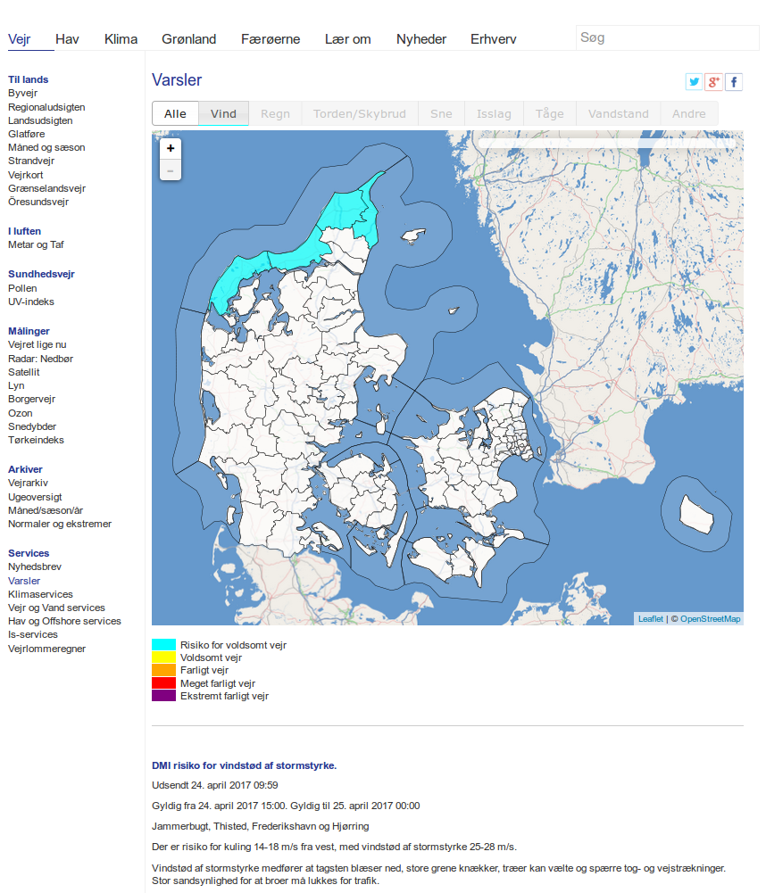
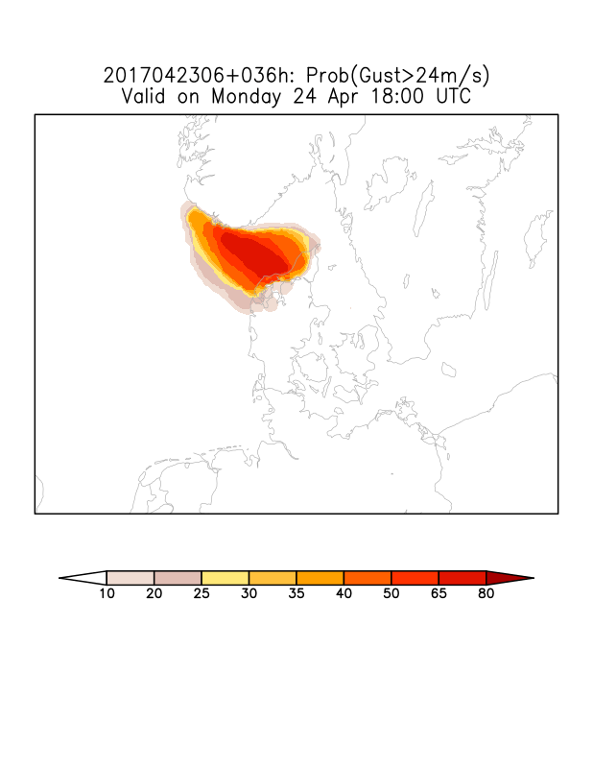
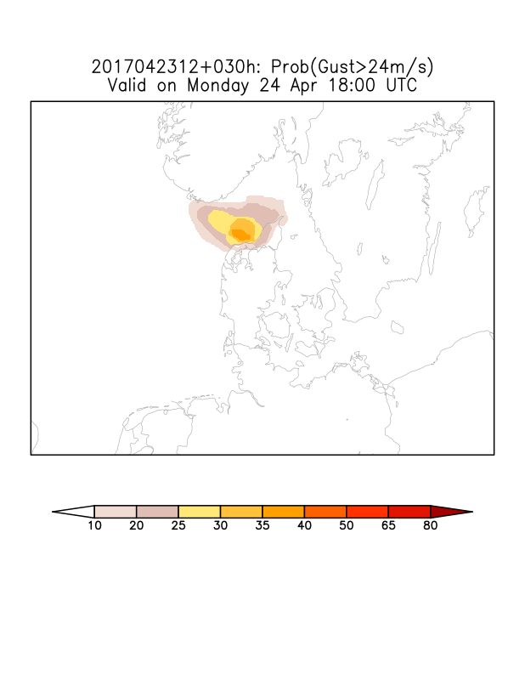
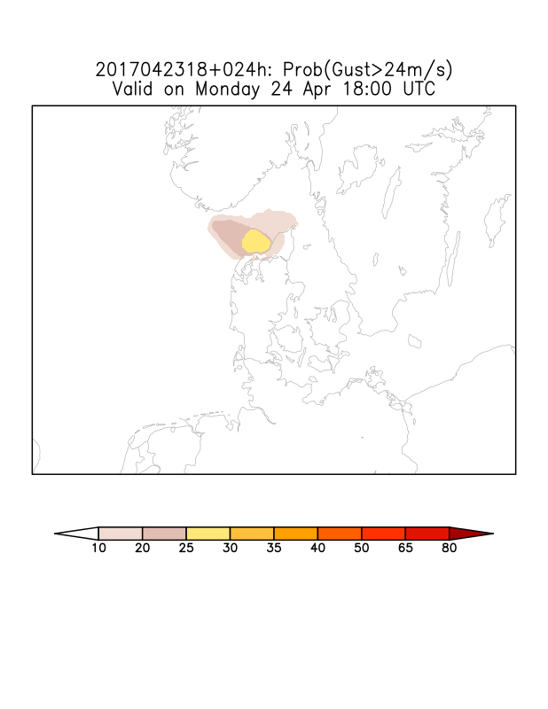
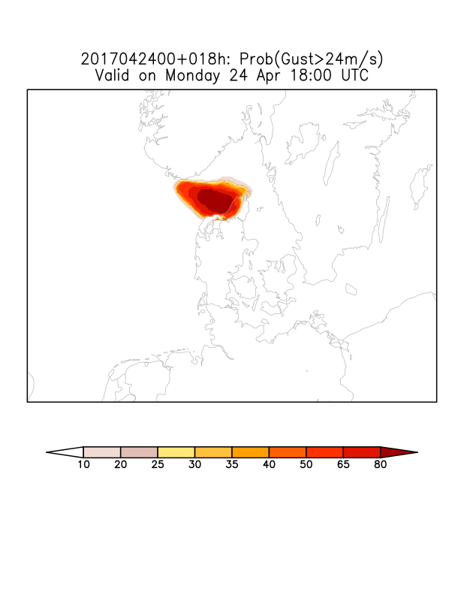
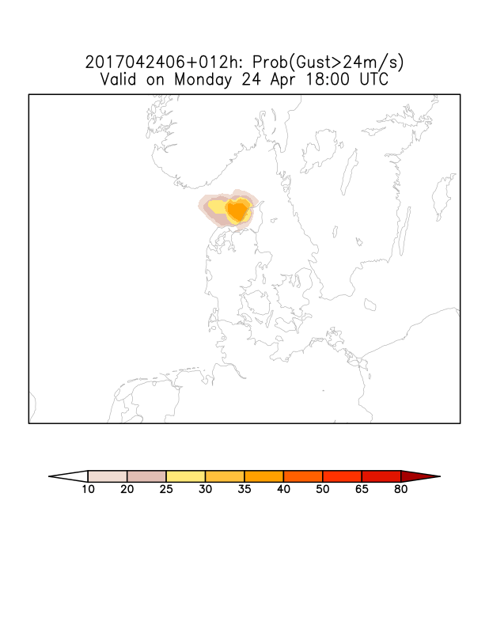
+36h
+30h
April 23, 18 UTC
HIRLAM-EPS (previous
operational)
6-hourly probability of
gust storm
Jumpiness is an issue!
+24h
+18h
+12h

Slide 29
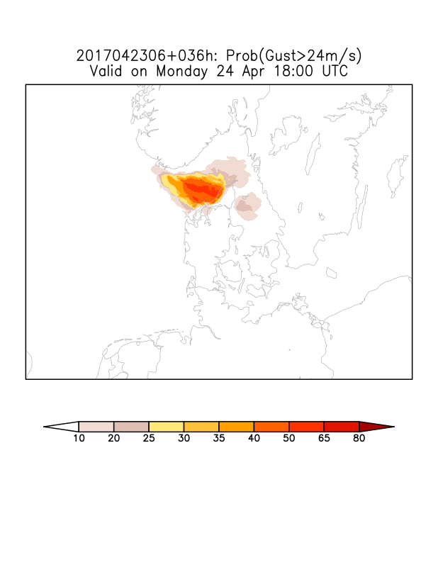
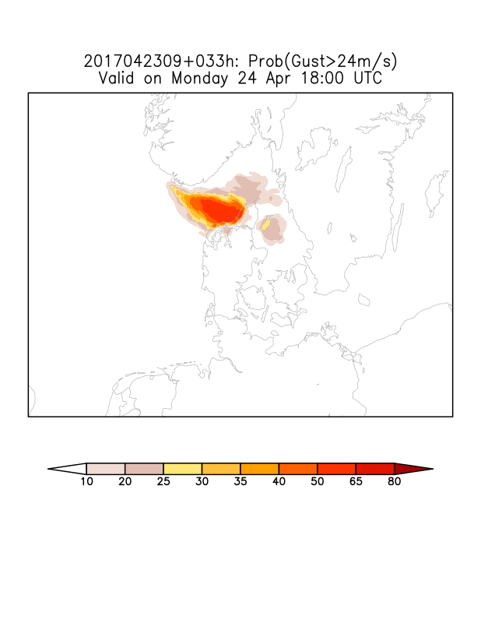
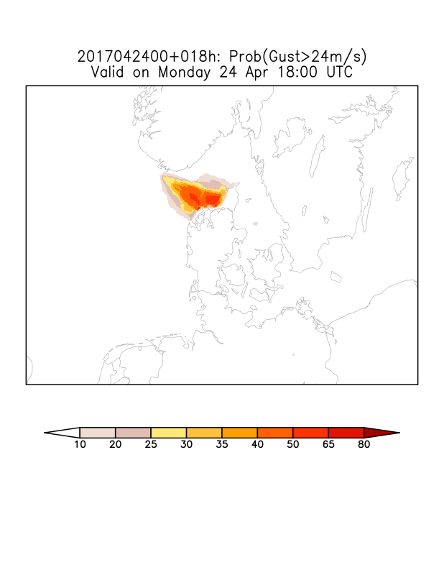
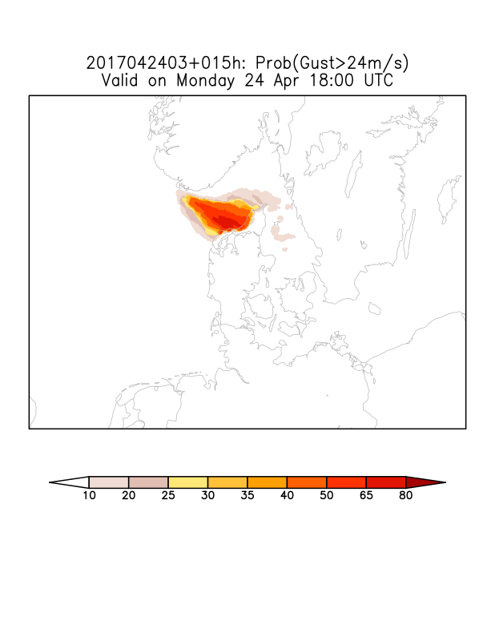
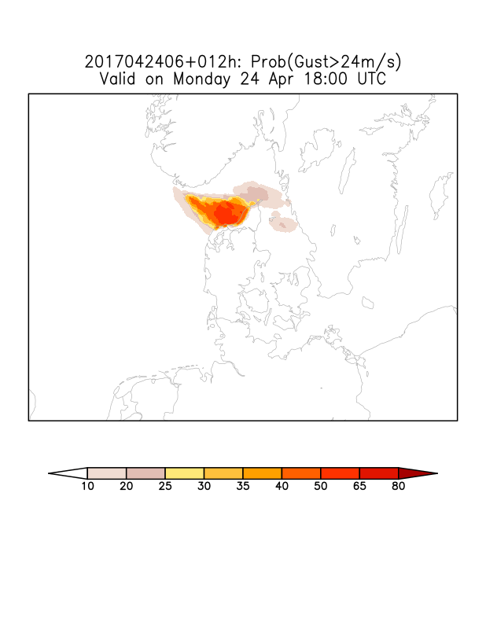
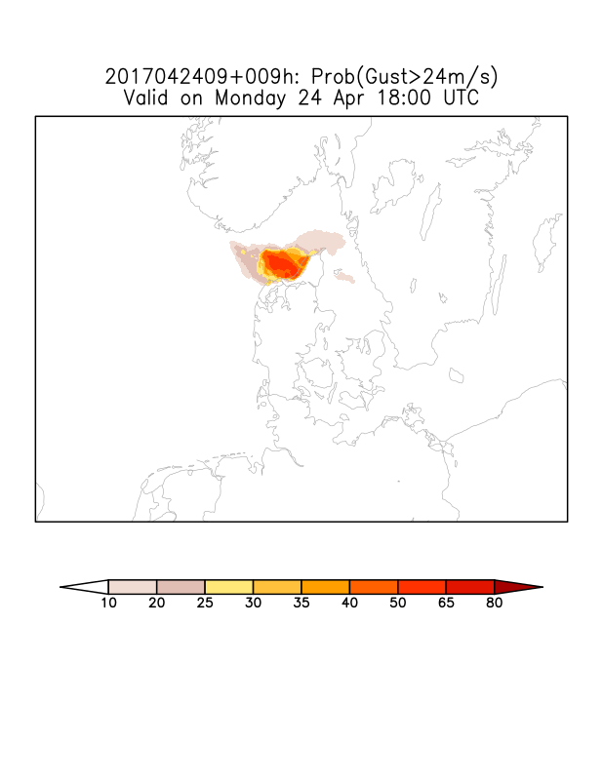
COMEPS Forecast
Probability of gust storm
Time lagging in COMEPS
reduces jumpiness...
+36h
+33h
COMEPS
+30h
+27h
+24h
+21h
See presentation by Henrik Feddersen later this year about EPS @ DMI

Slide 30
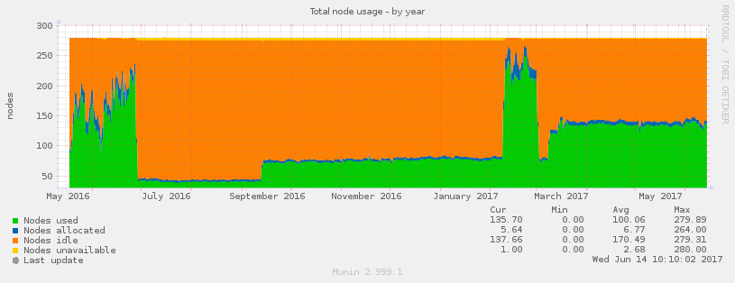
Utilisation of HPC capacity at DMI
COMEPS-eps system
Uses 1/3 of peak HPC
capacity at DMI
Operational cluster
(2017)
Research
cluster
Research
cluster
HARMONIE NEA/IGA launch
COMEPS launch
Xiaohua Yang, Data Assimilation in DMI-HARMONIE, 19 Jan 2021

Slide 31
COMEPS for nowcasting
& at sub-km resolution
Xiaohua Yang, Data Assimilation in DMI-HARMONIE, 19 Jan 2021

Slide 32
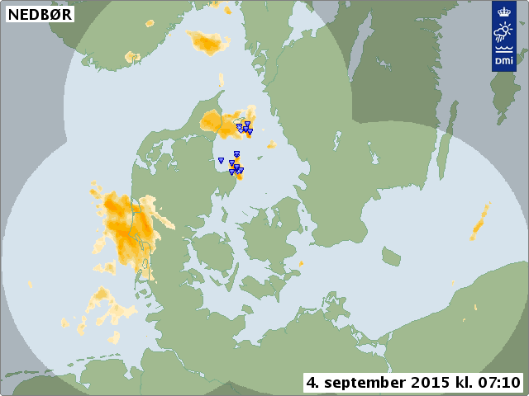
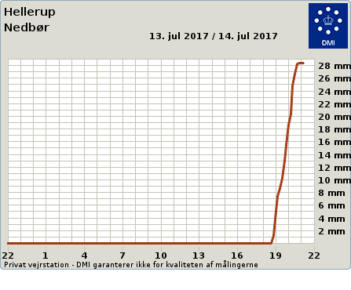
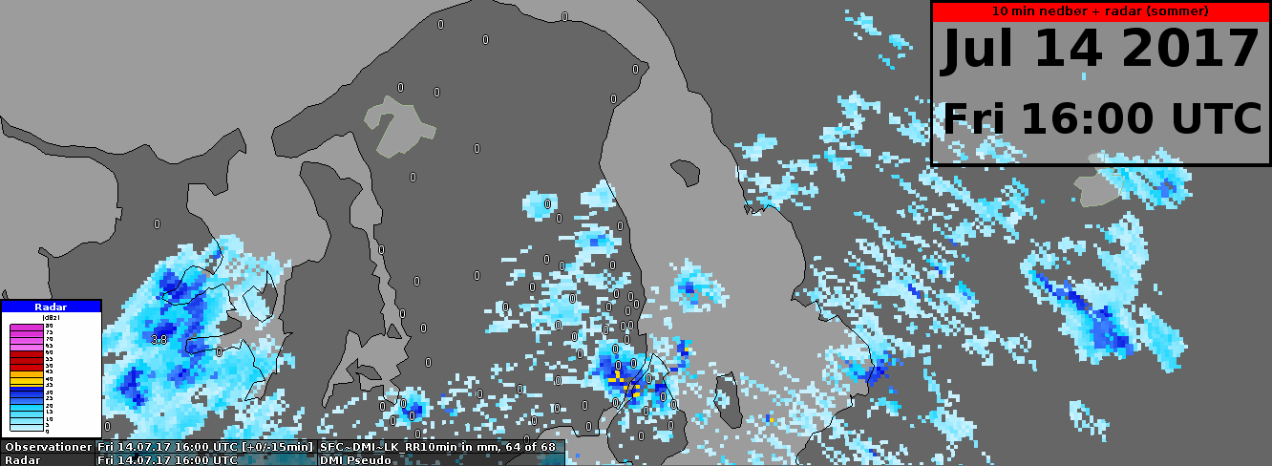
Sept 4, 2015
July 14, 2017
Some severe weather events have very limited spatial and temporal predictability ( thunderstorms, cloudbursts, gust)

Slide 33
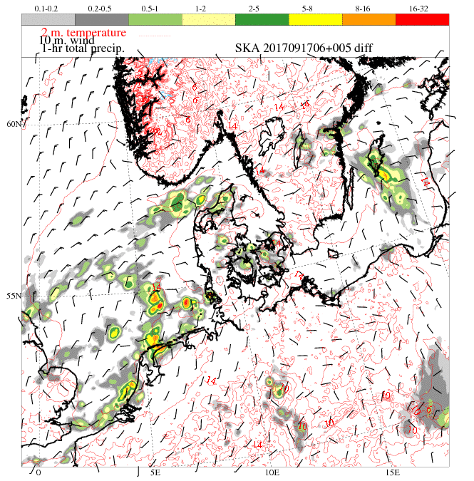
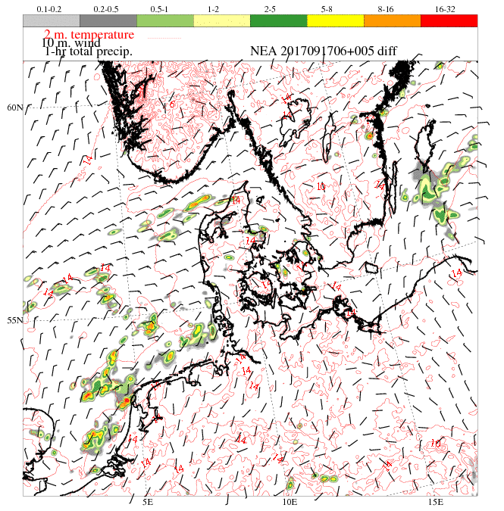
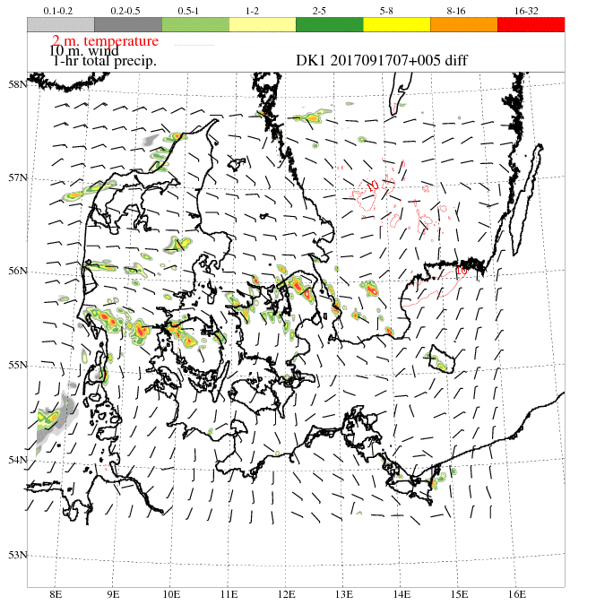
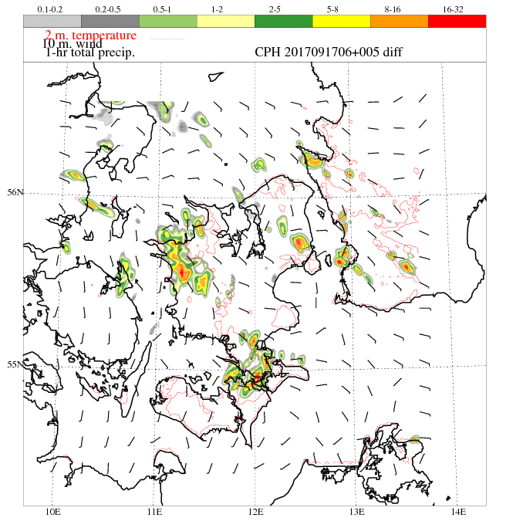
17 Sept 2017, 11 UTC, 1h accumulated
SKA-3 km
NEA-2.5 km
(Operational)
DK- 0.75 km
CPH- 0.5 km
Short range forecasts has progressively increased skills in prediction of strong convection... ...

Slide 34
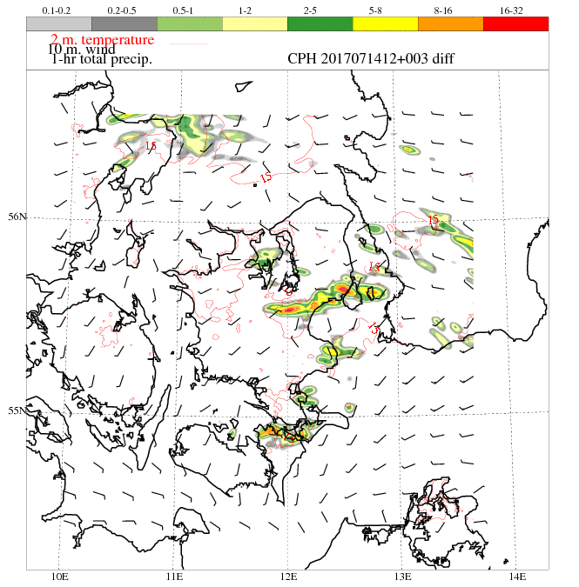
Physical realism with sub-km Harmonie-arome
July 14, 2017, Copenhagen flashflood
Sept 17, 2017, Copenhagen flashflood
Xiaohua Yang, HIRLAM-ALADIN ASM 2019

Slide 35
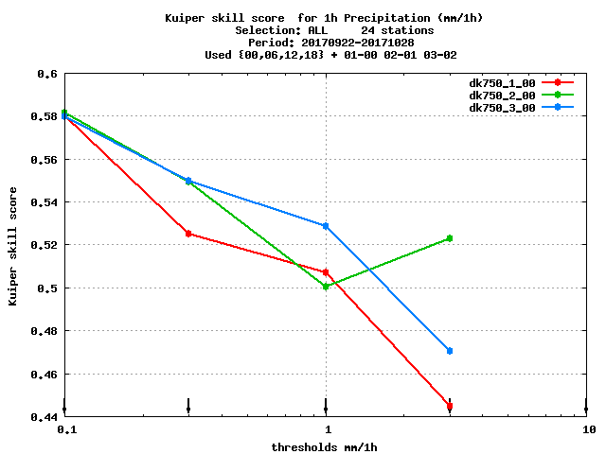
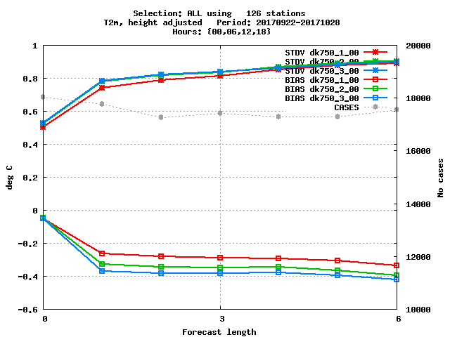
Std & bias
T2
KSS
Rain
1h cycling
2h cycling
3h cycling
Dilemma about assimilation window length & cycling frequency
1h cycling clearly advantageous for dry surface parameters like MSLP/T2m
But for cloud and precipitation, 1h cycling is less optimal compared to 2h/3h
Similar finding from test with 2.5 km Harmonie-arome (Yang and Randriamampianina, 2017)
Xiaohua Yang, HIRLAM-ALADIN ASM 2019

Slide 36
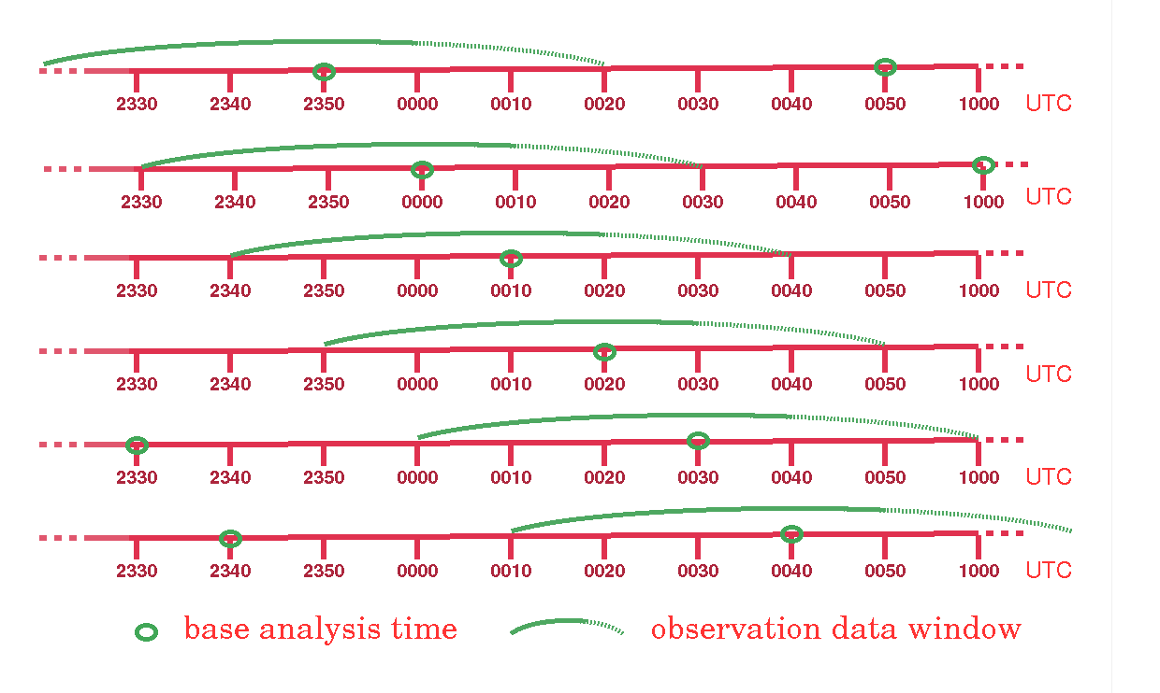
COMEPS-nowcasting:
Sub-hourly analysis, on overlapped windows
Sub-hourly launch
1h to 2h window
Update each 10 m
Elapse time 15 m
< 30 m after obs
Xiaohua Yang, Data Assimilation in DMI-HARMONIE, 19 Jan 2021

Slide 37
2018.06.01 14/15/16/17/18/19
Synop, radar, ground based GPS, crowdsourcing, all sky radiance... ...

Slide 38
Partially connected adjacent suites
Sub-hourly suite
1h to 2h window
Partial connection via surface DA
Separation of
BG/FG in VAR?
Xiaohua Yang, Data Assimilation in DMI-HARMONIE, 19 Jan 2021

Slide 39
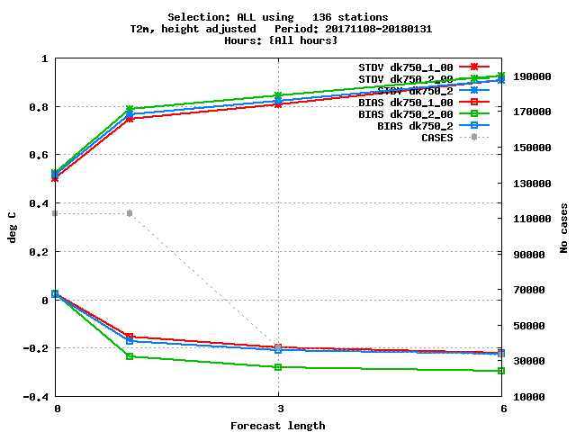
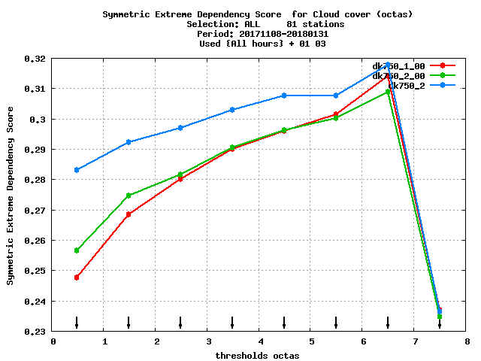
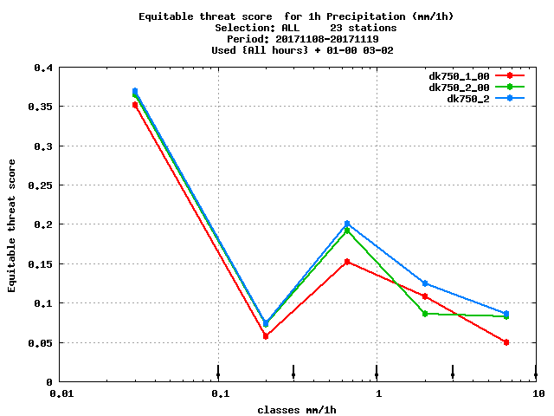
T2M, std&bias
Partial coupling
between adjacent suites
1 hour cycling
2 hour cycling, parallel
2 hour cycling,
partially connected
Cloud, ETS
1h Precipitation, ETS
Xiaohua Yang, Data Assimilation in DMI-HARMONIE, 19 Jan 2021

Slide 40
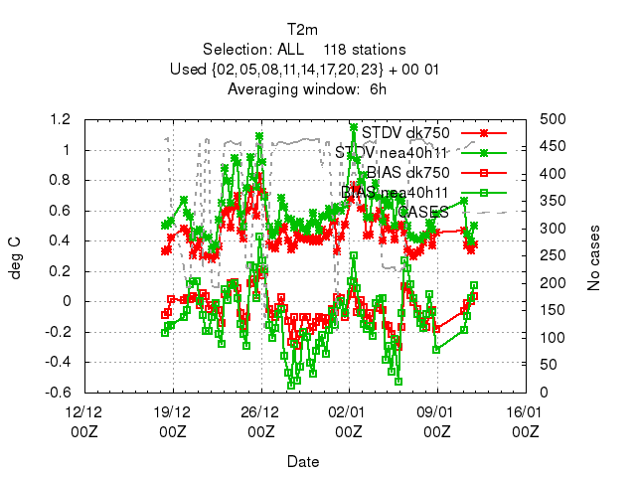
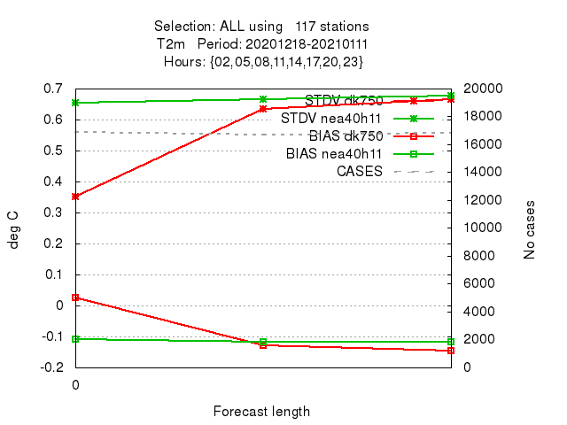
Verification of pre-operational nowcasting
nowcasting 750m
Operational 2.6 km
Aimed for operationalisation during 2021. Hourly suites at start.
Xiaohua Yang, Data Assimilation in DMI-HARMONIE, 19 Jan 2021

Slide 41
Reduced Aircraft Observation during COV19
12 UTC, Feb 6, 2020
12 UTC May 21, 2020
Xiaohua Yang, Data Assimilation in DMI-HARMONIE, 19 Jan 2021

Slide 42
Impact of reduced AO on forecast accuracy
Pressure
errors
Temperature
errors
With AO
Without AO
Wind
errors
Rain
Skill level
Simulation experiments comparing DMI-HARMONIE forecast during Feb 2020 with and without aircraft data. The model quality
is defined as averaged forecast fit to surface observations in Denmark. X-axis are forecast lead-time, Y-axis the errors in standard deviation and average offset for pressure, temperature and wind, skill level for rainfall. It is shown that loss of aircraft observation data causes noticeably larger errors in 1-day forecast for key weather parameters and degrade forecast skill.
Xiaohua Yang, R&D, DMI, Copenhagen June 2 2020

Slide 43
Thank you for your attention. Questions?

Slide 44
For HARMONIE model, the effective resolution is at the range of 9 ~ 10 DX, i.e., ~25 km. Smaller scale flows are distorted. Courtesy of Ricard et al, QJRMS 139, July 2013
Mean KE spectra for horizontal wind computed over the free troposphere (between about 3 and 9 km) for summer (JJA) 2009 (solid line) and winter (DJF) 2010 (dashed line): (a) averaged between 07 and 30 h operational AROME forecast; (b) for 1500 UTC operational AROME forecast. The dashed lines correspond to −3 and −5/3 slopes. (wileyonlinelibrary.com/journal/qj)

Slide 45
Shorter leadtime
=/=
Better forecast
Courtesy F. Meier., ZAMG Nowcasting, ASW 2016, Lisabon
Spin-up!

Slide 46
10th of May 2018
(Smart phone measurement in 1hz and from mobile population)
pressure anomaly pattern (colored circles) vs radar echo (shadows)
Showing passage of a cold front with embedded convection
Also Cars... ...
(Kasper Stener Hintz)
High frequency!

Slide 47
Measurement by civil observation network
NETATMO (Roel Stappers, met.no)
Note the high correlation between
rain rate and surface pressure tendency.

Slide 48
Challenges and constraints with sub-km NWP
extreme events typically come with small scales with limited predictability
short lifecycle and dense remote sensing data calls for a RUC system
improvement in forecast must come from both ensembles and high resolution
moisture spin-up a crucial concern for any RUC/Seamless system
uneven observation: either too few/sparse or too dense/frequent (+ radar, satellite, crowd source)
spatial and temporal correlation in observation data become a major concern
especially for data assimilation in high resolution and nowcasting
denser/quicker/more frequent not necessarily better
limited HPC resources: more ensemble or finer resolution?

